Slide 1
AI solution for child seat localization
Author: Julio cesar zanotto mastrodomenico

Slide 2
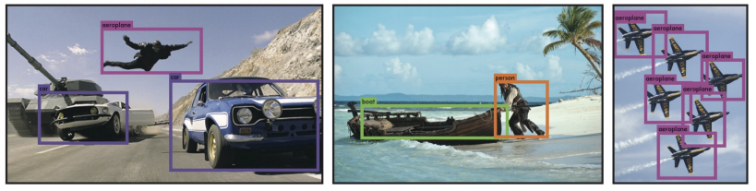
TASK – OBJECT DETECTION
As the goal is to detect an object in a image, this can be achieved by using Object Detection. Which means that the AI model will check the image for a specific object or several, and mark th position of the object. Hence Object Detection, below you can see na example of such task.
source: https://arxiv.org/pdf/1506.02640.pdf

Slide 3

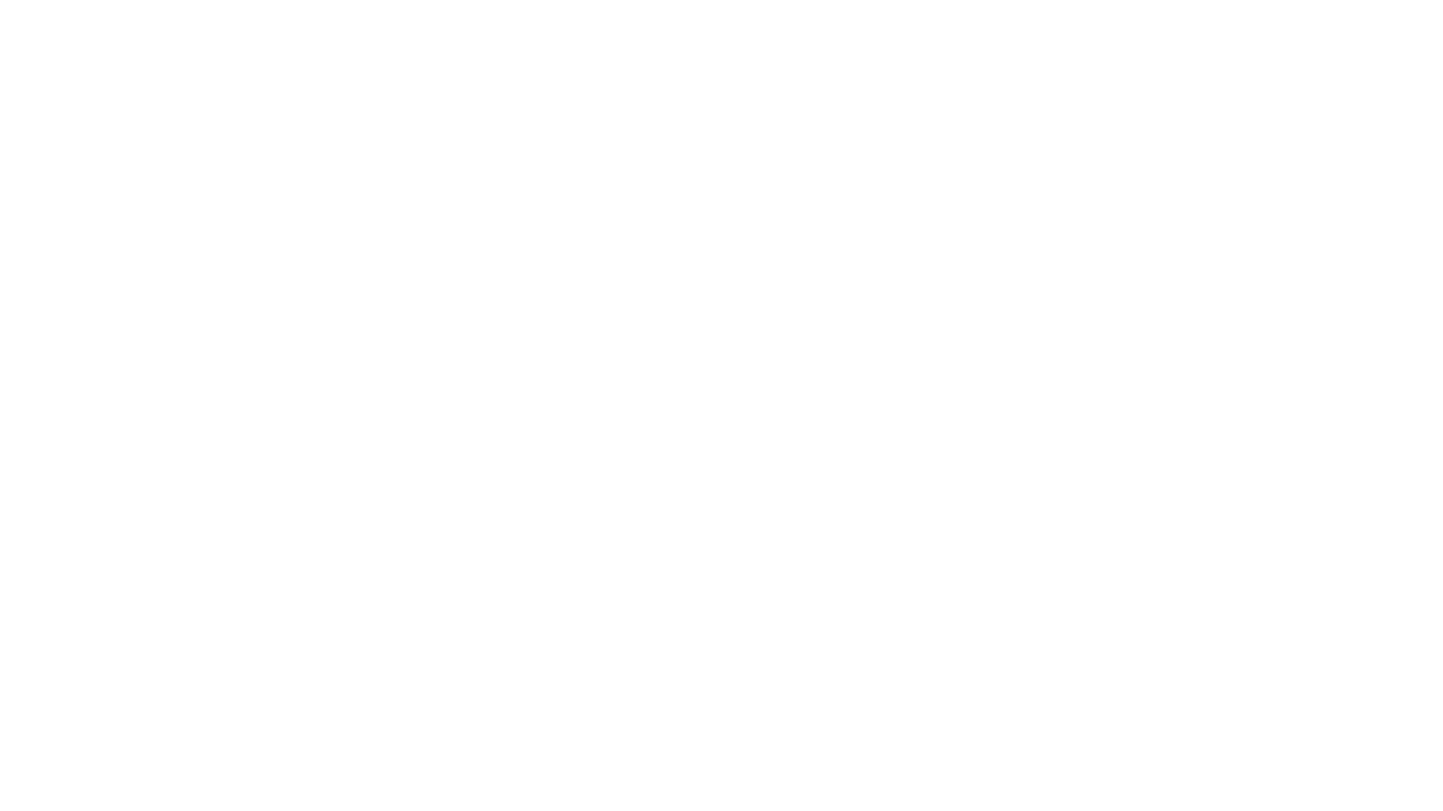
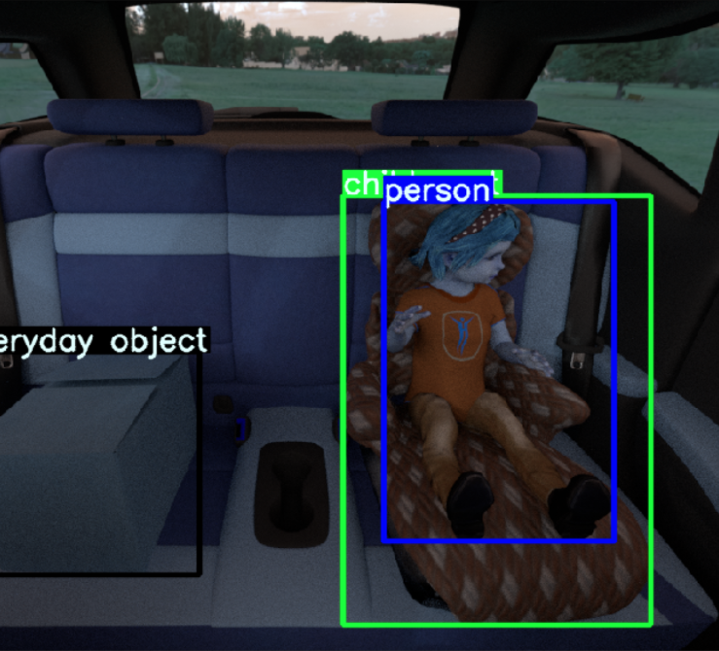
DATASET – SVIRO
SVIRO stands for Synthetic dataset for Vehicle Interior Rear seat Occupancy, therefore is a synthetic dataset made for evaluation of Machine Learning models so there is a common benchmark to tests.
It has data for other tasks such as keypoint detection and mask segmentation, and images on grayscale, RGB and InfraRed.
For this task I selected only the RGB images of 6 cars, with a total of 12.000 images to train and validate.
source: author

Slide 4
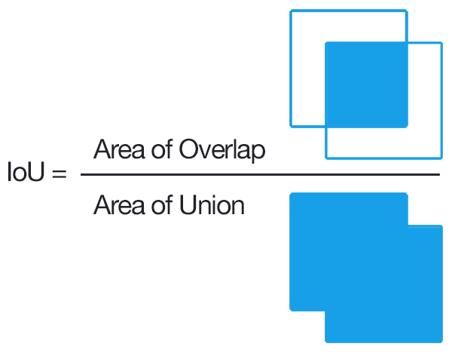
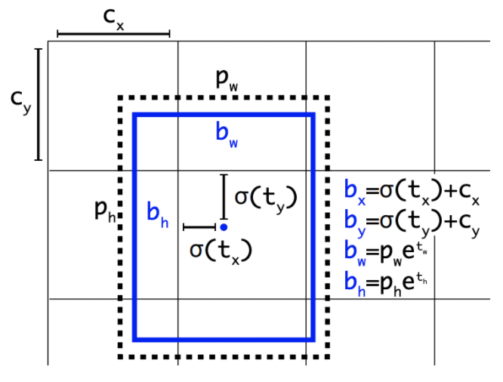
METHOD – YOLOV5
The method chosen to perform the task was the YoLov5. Yolo stands for You Only Look Once, it is a single shot, very straight forward method of object detection and it is now on the fifth version.
YOLO aims to do all in one passage, by passing the entire image at once, extracting the features of the entire image, classifying and doing the regression for the bounding boxes. The basic pipeline would be:
Extract the image features
Several anchor boxes are scattered through out the image grid, to each one the model applies an objectness score ( prediction )
A Non-Max Suppression is applied to keep only the boxes with the highest score and an IoU greater than 0.5
source: https://www.pyimagesearch.com/2016/11/07/intersection-over-union-iou-for-object-detection/
source: https://blog.roboflow.com/a-thorough-breakdown-of-yolov4/

Slide 5
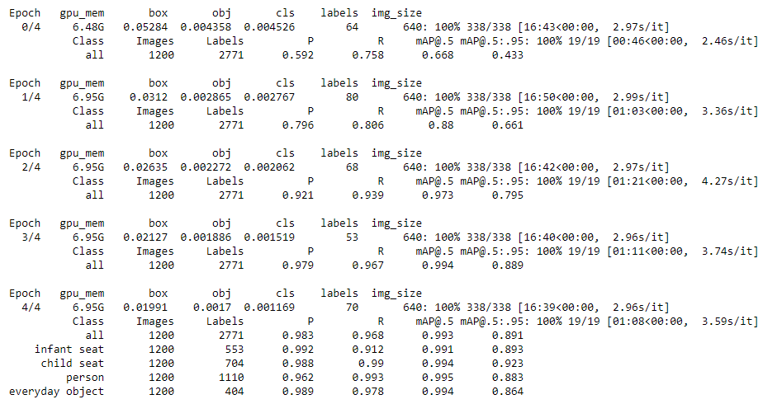
Training
The training was done using Google Colab’s GPU, for 6 epochs, using some of the fantastic repository features such as data augmentation and the fit one cycle learning rate.
The metrics used for model evaluation, as it is commonly used in object detection and localization was the mAP, the mean Average Precision across the classes AP curve.

Slide 6
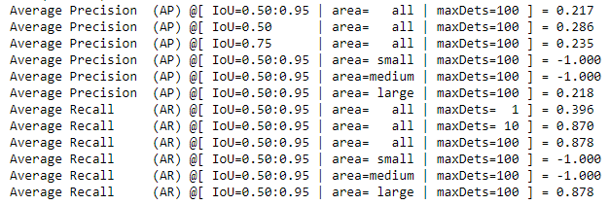
COCO Eval Results
I also used the metrics which SVIRO was calculated on, which is using the PyCOCOtools.
According to their benchmark, their mAP @ 0.5, was 0.65. Using only Gray images.

Slide 7
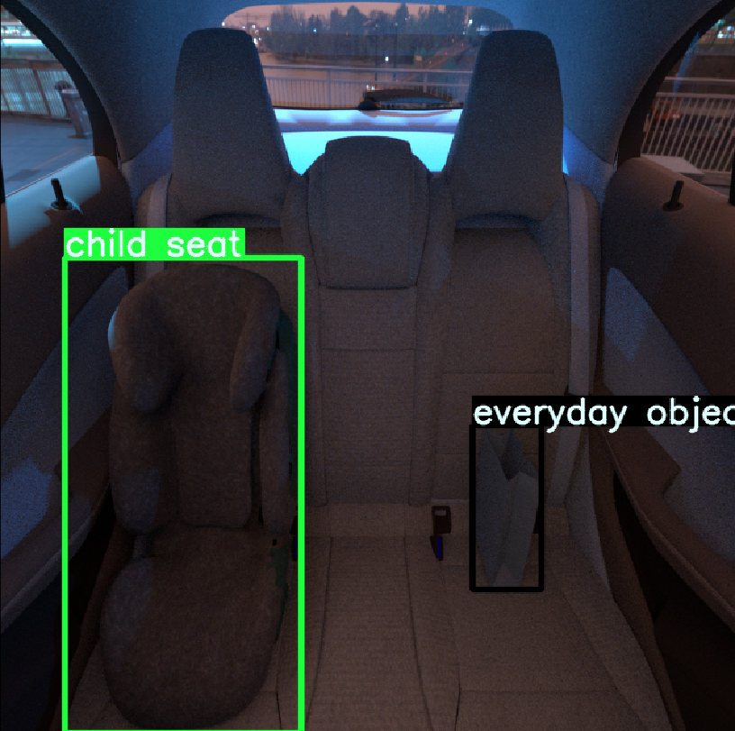
RESULTS
Here we can see the results from the model trying to predict the seat localization on the test image.
source: author

Slide 8
Next steps…
After checking the results and getting similar values with Yolo and COCO Eval, I would test also diferente models as the FasterRCNN, would like also to see the Detectron2 results.
Test different bounding box threatment method, instead of the NMS, use weighted box fusion as mentioned on: https://arxiv.org/abs/1910.13302
Some more augmentations, instead of spatial, use also pixel level augmentation such as Gaussian Noise and Blur, as synthetic images may have some high frequency noise, as I have experienced in some projects.
Fine tune the Focal Loss gamma, as the dataset is unbalanced, we have much more “person” class than “everyday object”.
And to use more images, the full dataset and mix gray with RGB for 2 different models and use the weighted box fusion for better results.

Slide 9
QUESTIONS ?
THANK YOU !!!

